Slide 1
Open-Source Radio Microcontroller for Fabrication
ECPE Senior Design May 2025, Team 27
Presenters: Nolan Eastburn, Nathan Stark, Ibram Shenouda, Ethan Kono, Will Custis, Noah Thompson
Faculty Advisor and Client: Dr. Henry Duwe
Team Website: https://sdmay25-27.sd.ece.iastate.edu/
References to Design Document on slides as DD <page number>
Notes:
Ibram

Slide 2
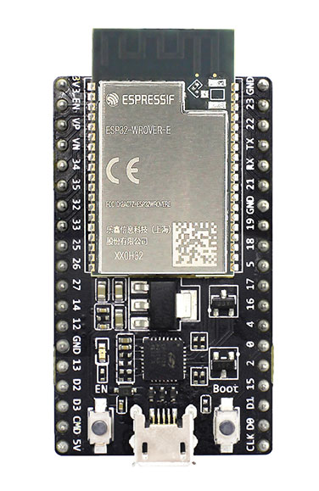
Problem Statement
The lack of open-source radio microcontroller designs makes learning about radio design for fabrication difficult for students and hobbyists.
Closed Source Radio Microcontrollers
[1]
[2]
[3]
DD 13

Slide 3
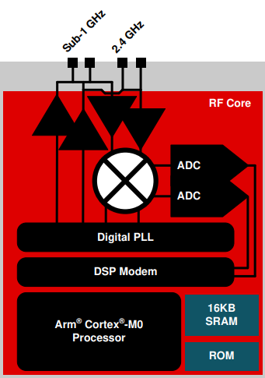
Market Research – Texas Instruments CC1352
Example of RF core architecture
Provides a variety of wireless communication protocols
Thread
Zigbee
Bluetooth
Multiple transmission frequencies
Ultra High (Sub GHz)
Super High (2.4 GHz)
[4]

Slide 4
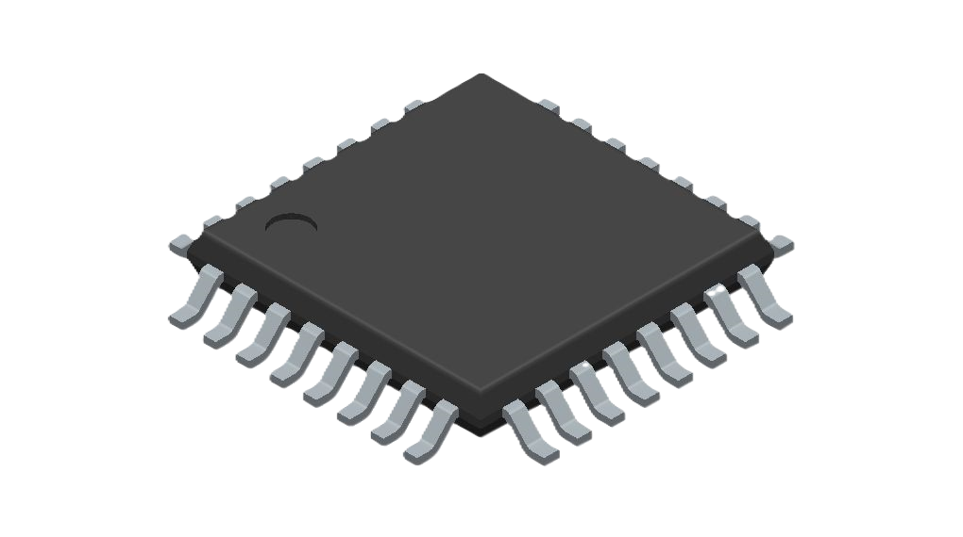
Requirements
MCU shall contain a radio subsystem
MCU shall implement an open standard wireless protocol stack
MCU shall contain two independent RISC-V cores to execute user programs
All the artifacts produced throughout the design of the MCU shall be open source.
Thorough documentation usable by students with only basic knowledge of circuits and digital logic.
DD 14
[6]
[5]
Notes:
To solve the problem in our problem statement, we devised requirements to implement our design against.
A summary of these requirements is listed here and is as follows: <list requirements and give a brief summary of why we added them>
See more on DD 14

Slide 5
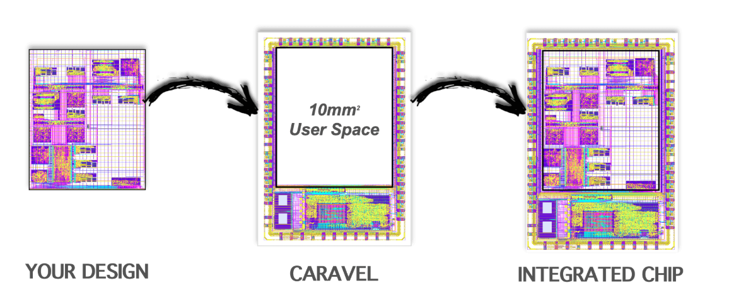
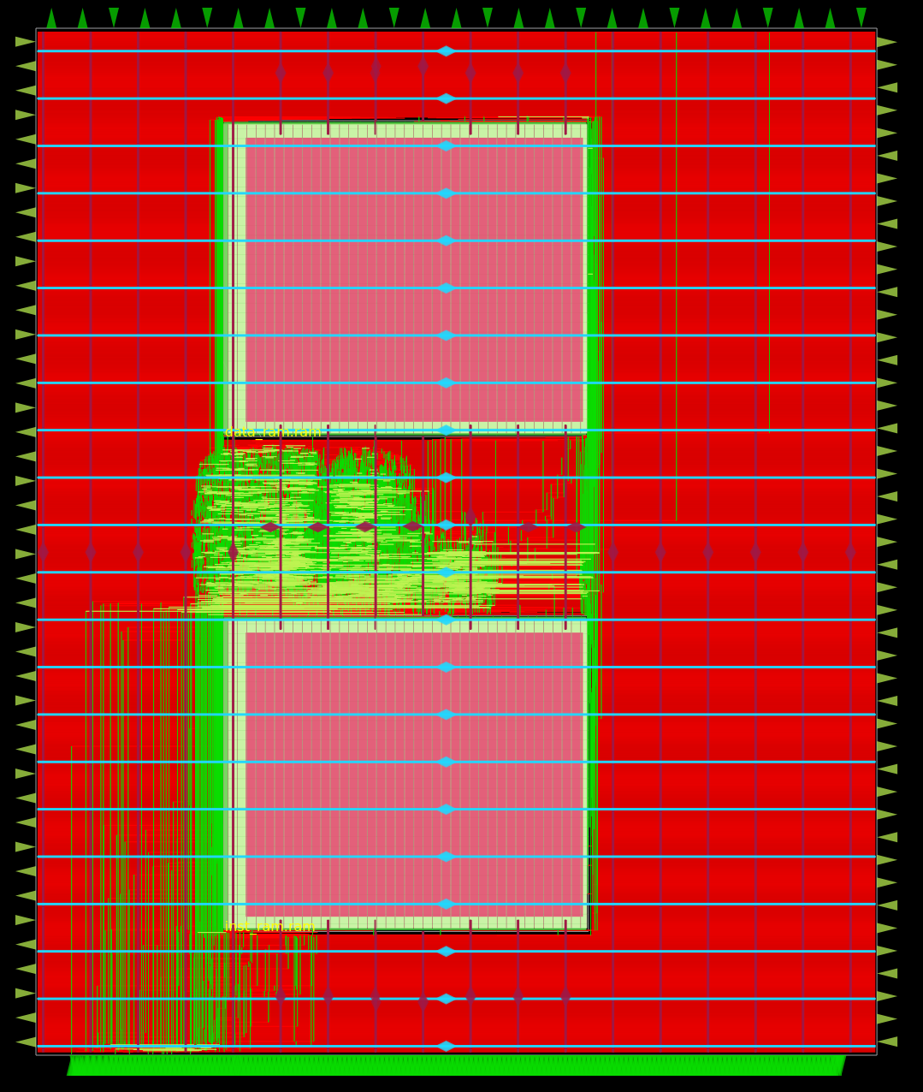
Technologies Used
Skywater 130 nm process
Provided by Efabless
Constraint from client
Caravel Harness
Proven wrapper for project
Openlane
Open-source tool for hardening digital designs
GNU Compiler Collection (GCC)
Compile C programs for RISC-V processors
Icarus Verilog
Simulate digital components to verify functionality
NGSPICE
Simulate analog components to verify functionality
[7]
[8]
[11]
[9]
[10]
Notes:
Only mention Skywater, Caravel, and Efabless marketplace directly.
Briefly mention that we have other tools we use that are listed on this slide for developing and testing all digital and analog artifacts.

Slide 6
Choosing a Wireless Communication Standard
What wireless communication standard will we implement?
Two major contenders:
Bluetooth and Zigbee
Bluetooth operates at 2.4 GHz while ZigBee operates at ~915 MHz
ZigBee is an open standard while Bluetooth is not.
DD 40
[12]
[13]
Notes:
Ethan

Slide 7
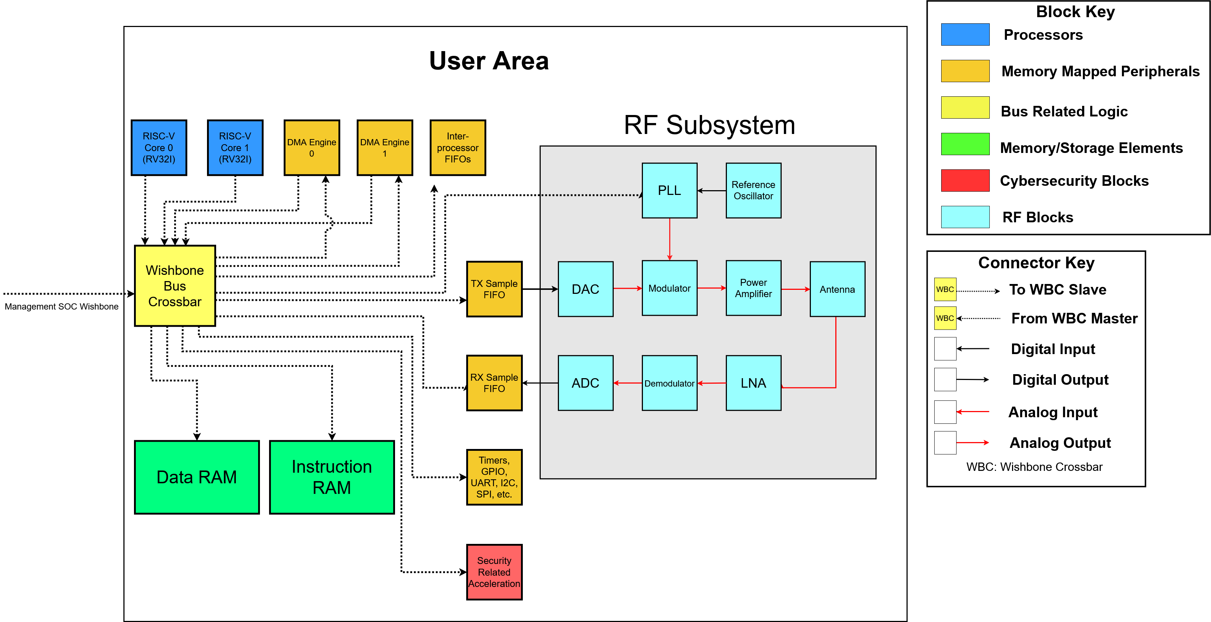
Detailed Design
DD 57
Notes:
Nolan

Slide 8
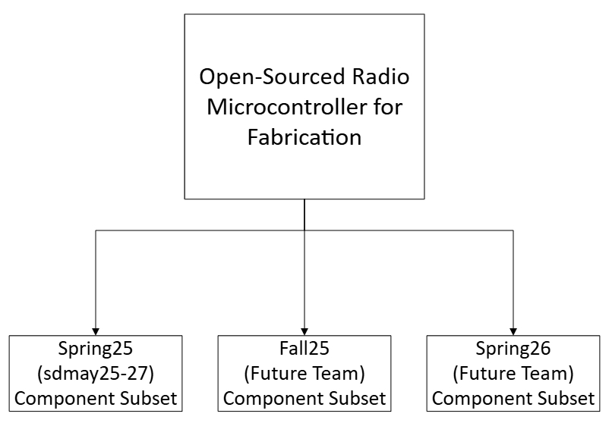
Potential Risks and Mitigation
Unknown open-source tools
Risks
Open-source tooling is different than tools team members have experience with
Less support and documentation
Mitigation
We have created a design outline for the complete project
We have chosen a subset of components to implement
Weekly meetings with client/advisor to update on status and keep scope reasonable
DD 25
Notes:
Noah

Slide 9
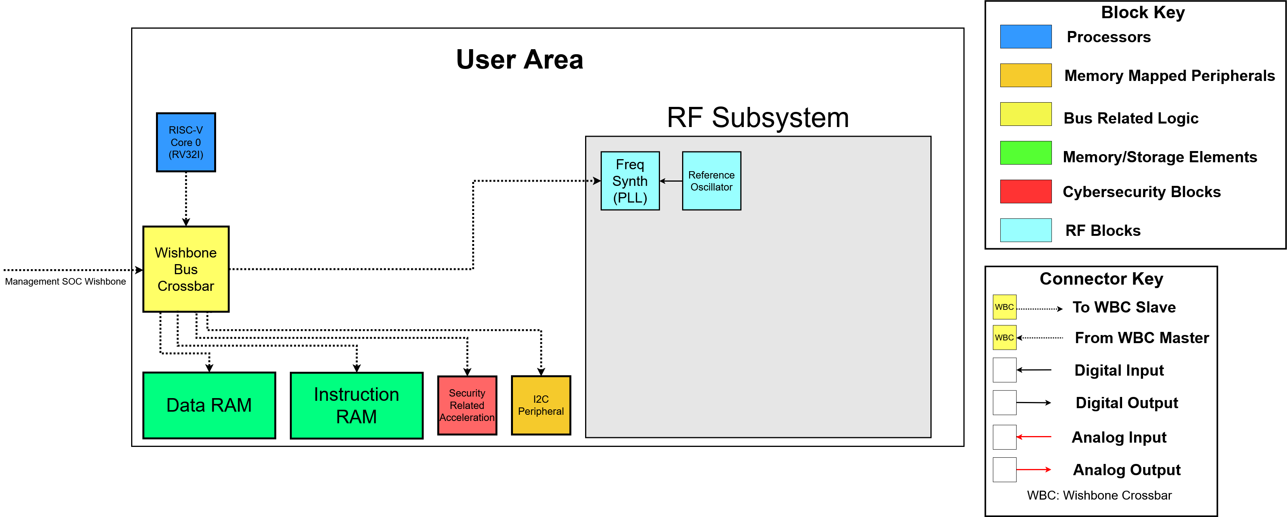
May 2025 Component Subset
DD 57
Notes:
Nolan

Slide 10
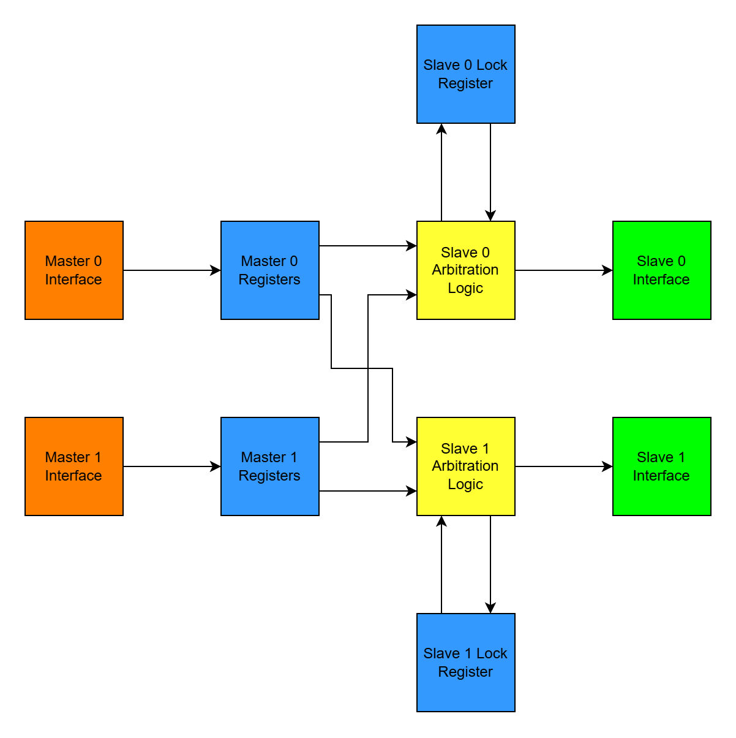
Digital Design – Wishbone Crossbar
Need a way to control access to memory while also maintaining high performance
Wishbone crossbar allows parallel access to different modules
Wishbone crossbar prevents simultaneous access to same module
Prototyped in first semester as proof of concept
A script was written to make the crossbar generic, allowing easy expansion to accommodate new modules
DD 70, 101

Slide 11
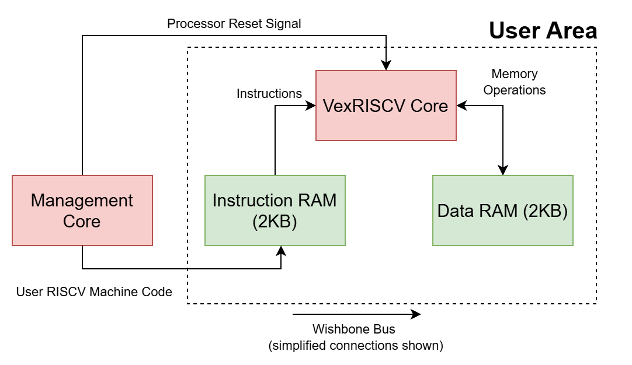
Digital Design – RISCV Core and RAM
A RISCV core in the user area will run user programs
Generated using VexRISCV, which is open source and Wishbone compatible
Instruction and data RAMs must be available to the user area RISCV core
Used existing Efabless DFFRAM macros and wrote a Wishbone slave interface for them
2KB for instruction RAM
2KB for data RAM
DD 72, 92

Slide 12
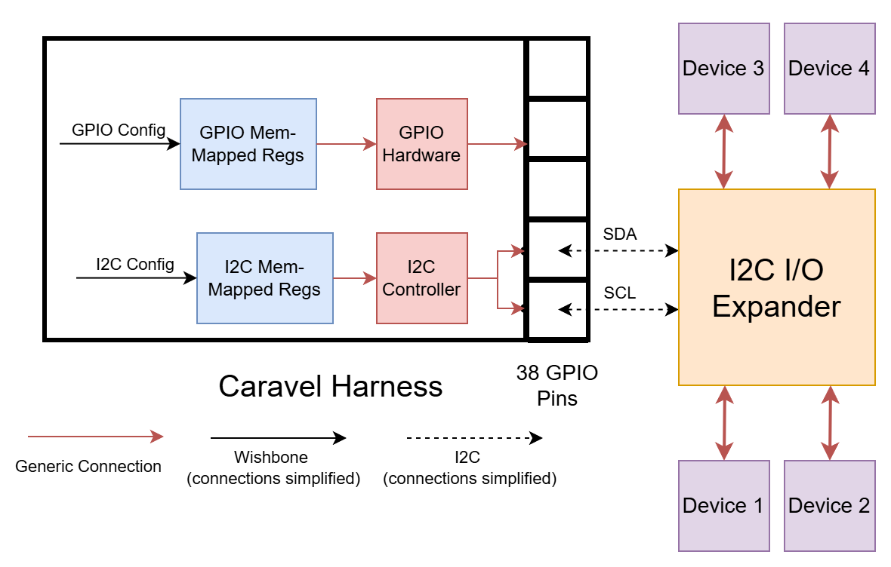
Digital Design - Peripherals
General purpose input/output (GPIO)
Provided by Caravel harness
Inter-integrated circuit (I2C)
Configured via memory-mapped registers
Uses GPIO with pullup resistors for SDA and SCL
I2C controller implemented in hardware
DD 70, 92

Slide 13
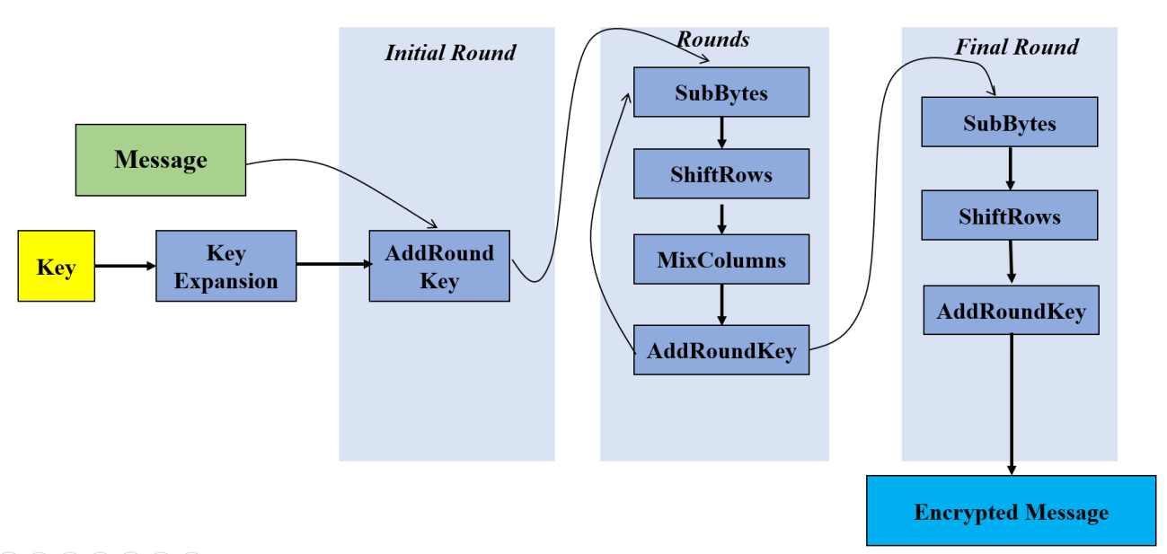
Digital Design – AES Accelerator
Evaluated potential security threats in radio microcontrollers (DD 133)
Encryption is a crucial feature in wireless communication.
AES was chosen due to its efficiency and being part of ZigBee.
We chose to implement an open-source option from the Efabless marketplace. (DD 105)
[14]

Slide 14
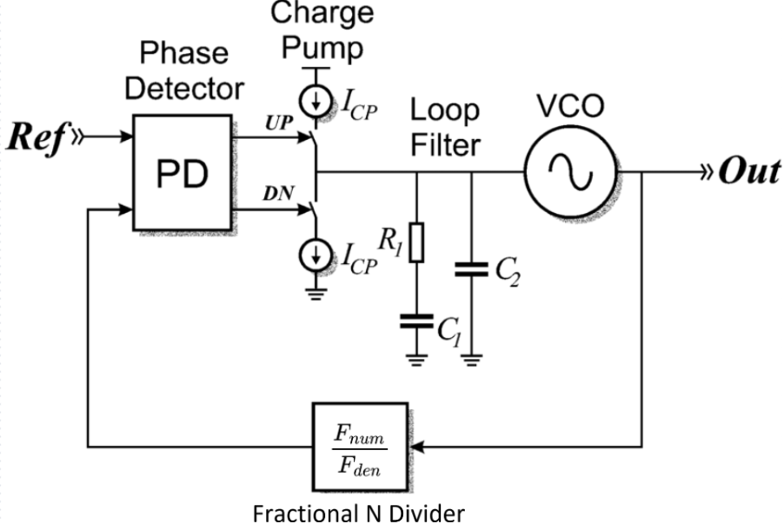
Analog Design – Frequency Synthesizer
[15]
Notes:
Noah and Ibram

Slide 15
Unexpected Risk – Efabless Shutdown
We found out in late March that Efabless has shutdown
We will not be able to fabricate our chip
We still can implement our project and run tests
Layouts can also still be generated so if Efabless comes back, we will be set to send our design off for fabrication
DD 31
[17] & [18]
[16]

Slide 16
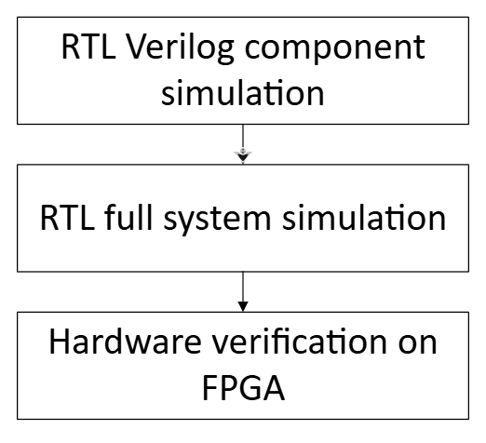
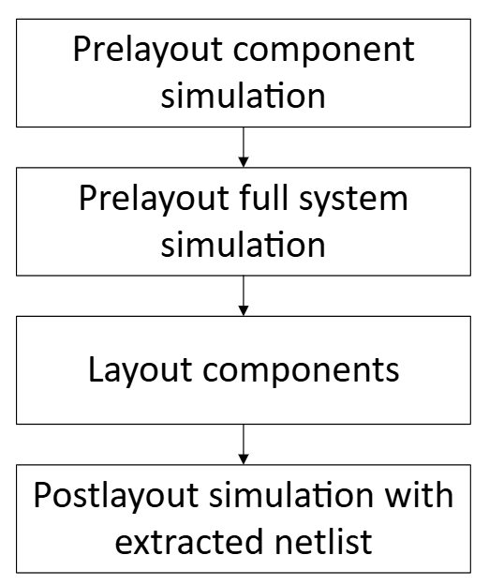
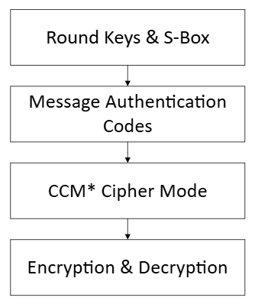
Testing Plan DD 65
Digital | Analog | Security

Slide 17
Digital Results
Wishbone Crossbar | Second RISCV Core | DFF RAM | I2C | AES
Parallel access verified Arbitration verified Address mapping verified | Reset verified Program execution verified | Reads and writes verified Half word and byte reads and writes verified Confirmed to synthesize and function on FPGA | Addressing verified Reads and writes verified Multi-byte reads and writes verified | Message Authentication Verified Encryption & Decryption Verified
DD 78-86

Slide 18
Digital Demo Video

Slide 19
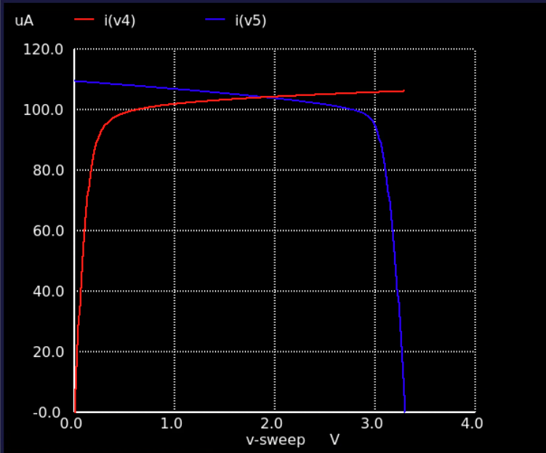
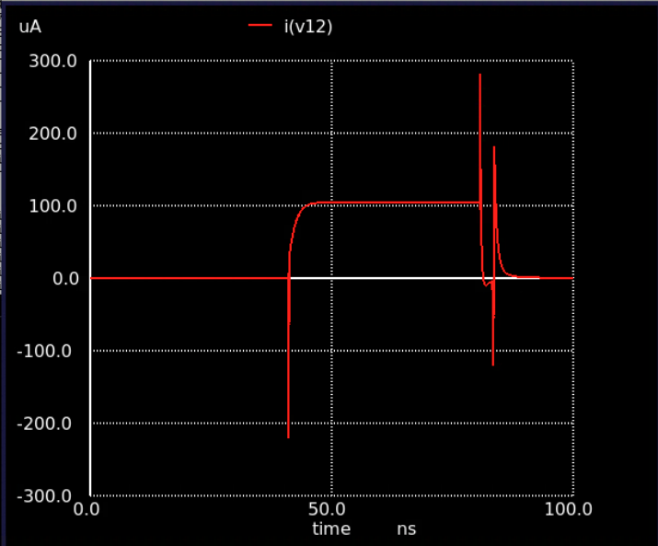
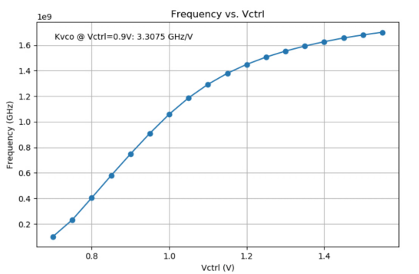
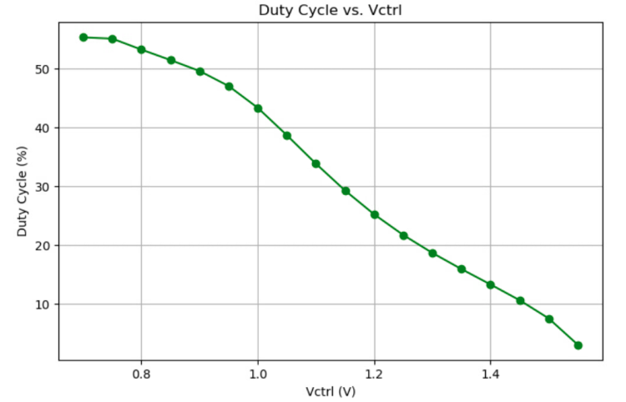
Analog Results DD 84
Charge Pump | PFD and Charge Pump | VCO

Slide 20
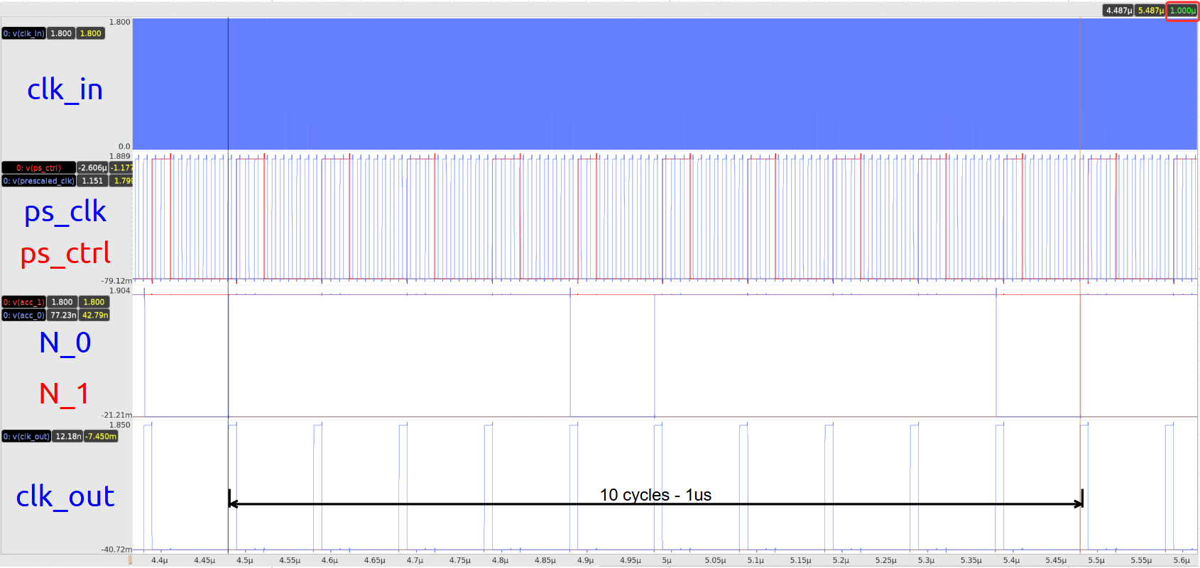
Analog Results – Fractional Divider DD 87

Slide 21
Future Work
Continue to expand on the design with the plan of developing it into diagram shown in the detailed design that includes a more well outlined digital and RF subsystem.
Add and continue to refine documentation as project develops.
Expand software libraries as digital and analog components are added.
Integration of both digital and analog subsystems.
Fabrication of the MCU

Slide 22
Conclusions – What We Have Accomplished
Substantial progress in creating the components for a fully functioning open-source radio microcontroller
Second RISCV core
DFF RAM
Wishbone Bus Crossbar
I2C
AES 128-bit encryption
Divider
PFD
Charge-pump
VCO

Slide 23
Questions?
ECPE Senior Design May 2025, Team 27
Notes:
Ibram

Slide 24
Image References
[1] "ESP 32" Accessed: 5/6/2025. [Online]. Available: https://mm.digikey.com/Volume0/opasdata/d220001/medias/images/425/MFG_ESP32-DEVKITC-VE.jpg
[2] "PI Pico" Accessed: 5/6/2025. [Online]. Available: https://cdn-shop.adafruit.com/970x728/5544-02.jpg
[3] "STM" Accessed: 5/6/2025. [Online]. Available: https://newsroom.st.com/wp-content/uploads/2020/12/STM32WL_MM_launch_P4314S_big.jpg
[4] "TI CC1352" Accessed: 5/6/2025. [Online]. Available: https://www.ti.com/content/dam/ticom/images/products/ic/wireless-connectivity/evm-board/launchxl-cc1352r1-angled.png
[5] "Generic Microcontroller" Accessed: 5/6/2025. [Online]. Available: https://www.electronics-lab.com/wp-content/uploads/2020/06/TQFP-32-Photo.jpg
[6] "Wifi Waves" Accessed: 5/6/2025. [Online]. Available: https://static.vecteezy.com/system/resources/previews/010/518/706/non_2x/sound-radio-wave-icon-wifi-sound-signal-connection-for-graphic-design-logo-website-social-media-mobile-app-ui-illustration-vector.jpg
[7] "Skywater Logo" Accessed: 5/6/2025. [Online]. Available: https://chambermaster.blob.core.windows.net/images/customers/7798/members/22311/logos/MEMBER_PAGE_HEADER/SkyWater_Logo2.png
[8] "Ngspice Logo" Accessed: 5/6/2025. Available: https://ngspice.sourceforge.io/images/nglogo.jpg
[9] "Icarus Verilog Logo" Accessed: 5/6/2025. [Online]. Available: https://upload.wikimedia.org/wikipedia/en/c/cb/Icarus_Verilog_logo2.png
[10] "Caravel Harness Description" Accessed: 5/6/2025. [Online]. Available: https://umsousercontent.com/lib_CUsguFEVafmoKCKW/6wufw19k0ioc1fwu.png
[11] "GNU Logo" Accessed: 5/6/2025. [Online]. Available: https://mediaresource.sfo2.digitaloceanspaces.com/wp-content/uploads/2024/04/29171315/gnu-logo-146F1DDF52-seeklogo.com.png
[12] "ZigBee Logo" Accessed: 5/6/2025. [Online]. Available: https://www.tuv.com/content-media-files/master-content/services/products/p03-electrical/1163-tuv-rheinland-zigbee-testing-and-certification/tuv-rheinland-zigbee-logo_core_1_x.jpg
[13] "Bluetooth Logo" Accessed: 5/6/2025. [Online]. Available: https://www.bluetooth.com/wp-content/uploads/2019/04/cropped-Bluetooth_FM_Color-1-223x300.png
[14] "AES Block Diagram" Accessed 5/7/2025. [Online]. Available: https://labs.dese.iisc.ac.in/embeddedlab/aes-encryption/
[15] R. C. H. van de Beek, C. S. Vaucher, D. M. W. Leenaerts, E. A. M. Klumperink, and B. Nauta, “A 2.5-10-GHz clock multiplier unit with 0.22-PS RMS jitter in standard 0.18-/SPL MU/M CMOS,” IEEE Journal of Solid-State Circuits, vol. 39, no. 11, pp. 1862–1872, Nov. 2004. doi:10.1109/jssc.2004.835833
[16] "Shutdown Notice." Efabless Notice. 5/6/2025. [Online]. Available: https://efabless.com/notice
[17] "Efabless Logo" Accessed: 5/6/2025. [Online]. Available: https://store.efabless.com/cdn/shop/files/logo_large_4fb22d13-6eef-4eac-9cd6-c7cd23939317.png?height=628&pad_color=ffffff&v=1702973184&width=1200
[18] "Explosion Clipart" Accessed: 5/6/2025. [Online]. Available: https://www.clker.com/cliparts/k/X/G/n/A/J/explosion.svg

Slide 25
Extra Slides
ECPE Senior Design May 2025, Team 27
Notes:
Ibram

Slide 26
Quantitative Technical Requirements
The radio signal’s phase noise will be below -41dBm/100Hz at a 32MHz offset per IEEE standard 802.15.4
The radio signal’s spurious emissions will be below -20dBc per IEEE standard 802.15.4
The design shall contain 4 KiB of RAM accessible to the user
2 KiB for data
2 KiB for instructions for second RISCV core
All Wishbone masters and slaves will use a 10 MHz reference clock which will be shared with the management SoC
Die space limited to 2.92 mm x 3.52 mm
Notes:
Ethan

Slide 27
Security Analysis
Vulnerabilities | Countermeasures
Control flow manipulation Fault attacks Side-channel attacks Sniffing data Replay attacks Repairing attacks | Encryption Authentication Code obfuscation
Due to the scope of the project not every possible vulnerability could be addressed. Encryption made the most sense to be the first security measure implemented due to over the air communications being incredibly easy to intercept. As the project continues to develop with future groups, we hope that more of these security measures will be implemented.

Slide 28
Crossbar Simulation Waveform

Slide 29
DFF RAM Waveforms

Slide 30
RISC-V Instruction Fetch

Slide 31
RISC-V Data Write

Slide 32
RISC-V Data Read

Slide 33
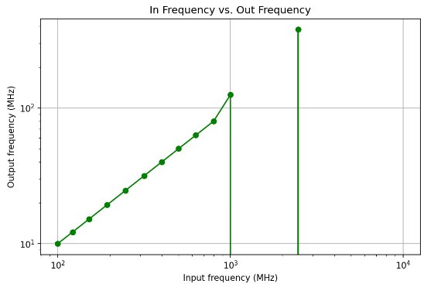
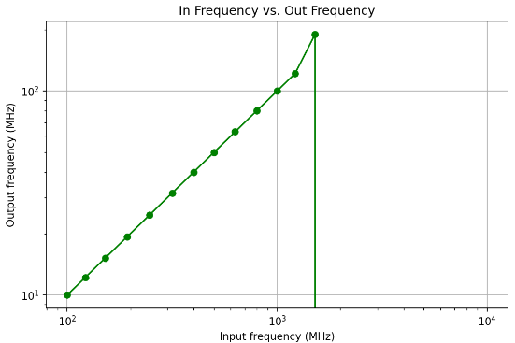
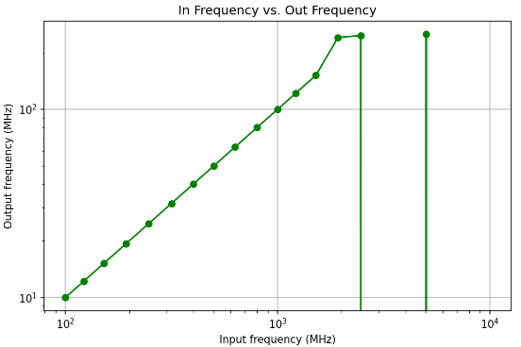
Divider Sweep Results
Corners - ss | Corners - tt | Corners - ff
Breakdown past 800MHz | Breakdown past 1.2GHz | Breakdown past 1.5GHZ

Slide 34
Problem Statement
Closed Source Radio MCUs
Existing radio microcontroller units (MCUs) have closed source designs
Difficult for ISU students, ChipForge (ASIC design ISU club) members, and radio hobbyists to learn about how radio MCUs work
Need an open-source MCU design that can be fabricated (silicon proven)
[1]
[2]
[3]
Notes:
Ibram

Slide 35
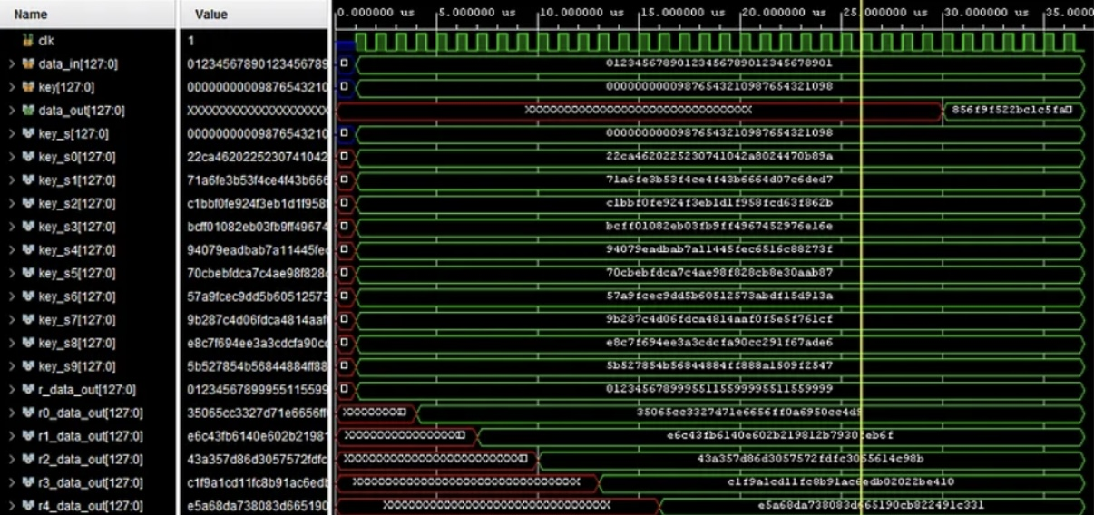
Security Testing Results

Slide 36
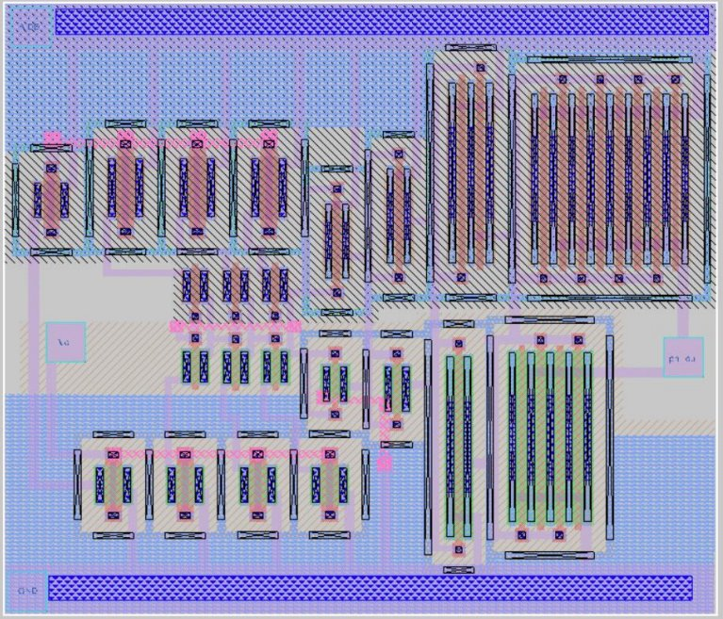
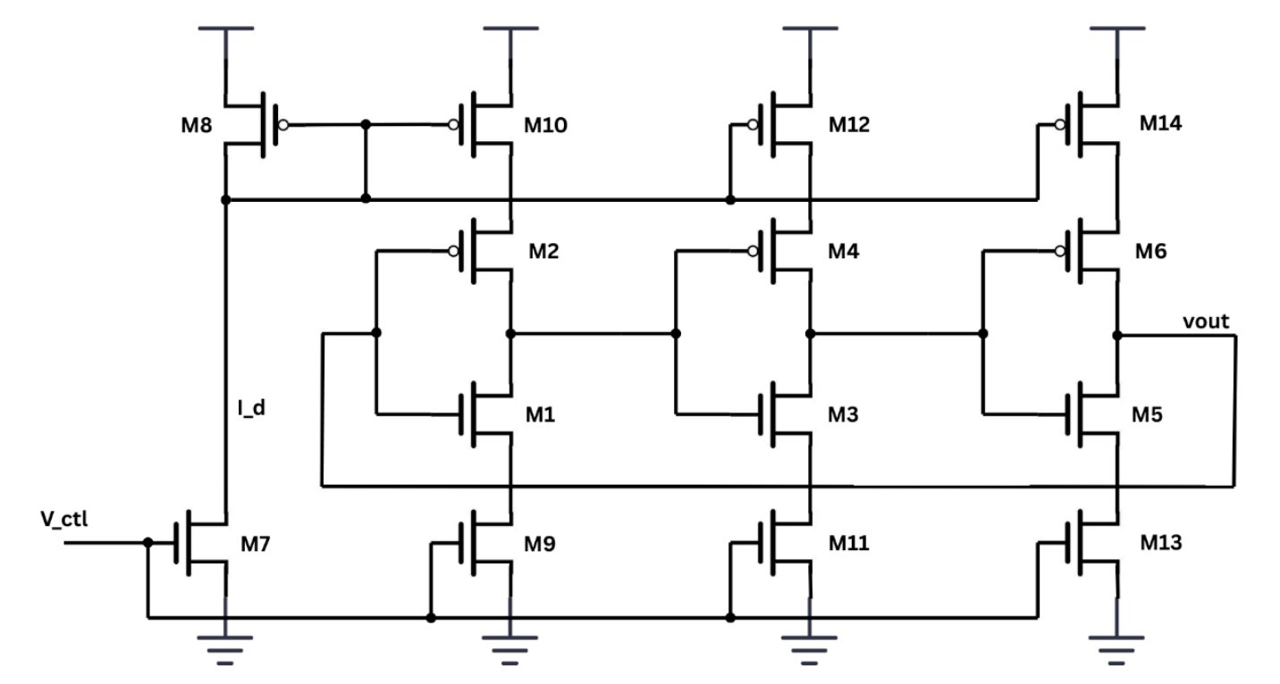
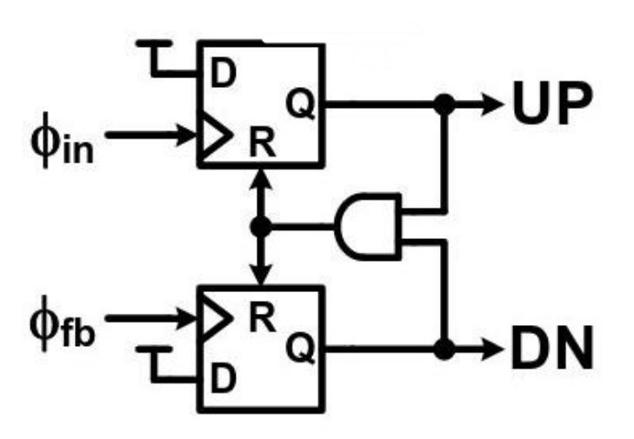
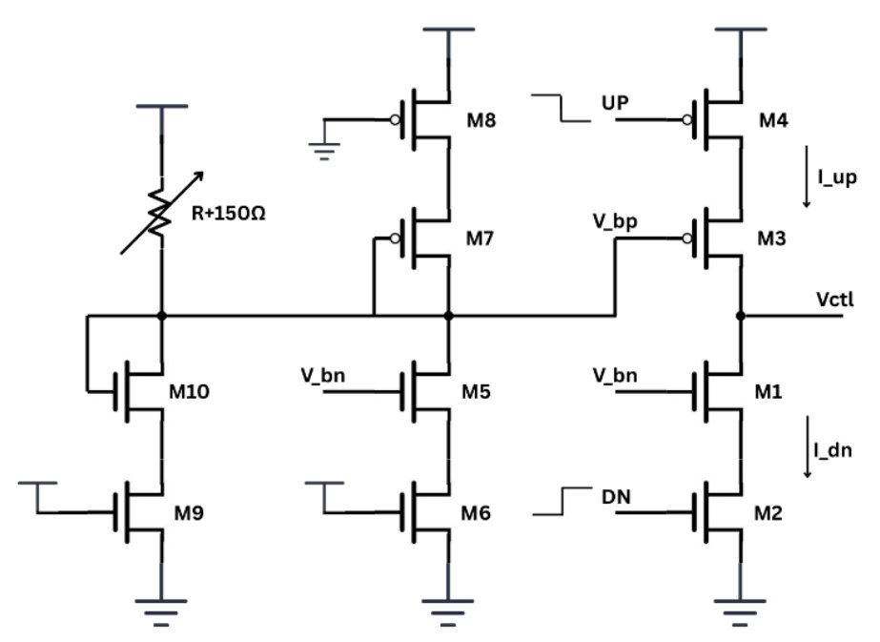
VCO, PFD, CP
Notes:
Noah and Ibram

Slide 37
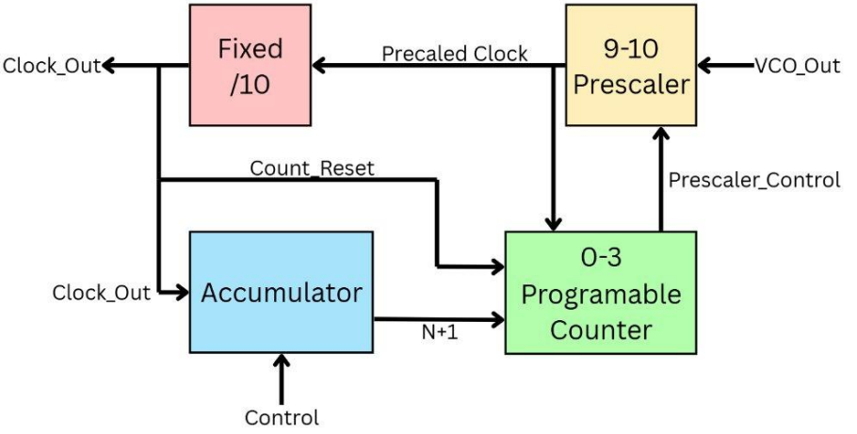
Fractional Divider

